Slide 1
Managerial Economics
Gopal Naik,
Professor, Economics and Social Sciences

Slide 2
What are the key decisions made by the product managers?
Design of the product?
  What features? Profitability?
  What size?
  What packaging?
Production?
  How much?
Where to sell?
  What market?
  What segment?
  What promotion?
  What Price?

Slide 3
What Inputs are Needed to Make these Decisions?
Product Development
  What consumers want?
  Segment size?
  Profitability?
Production facility
  Technology of production?
  Capacity?
  Resources?

Slide 4
Market
Market
  Structure
  Conduct
  Competition
  Regulation
  Policy

Slide 5
Markets
  Demand – major factors affecting demand
    What type of change in the demand?
    How are consumer preferences and behaviour changing?
  Supply – major factors affecting supply
  Market structure – number of players, how they compete
Domestic and International Markets

Slide 6
Analysis of related markets
Input market
    Supply
    Demand
By-product market
Substitute Products markets

Slide 7
Government Policies
Import – export policies
Taxes, subsidies
Experiences of other countries

Slide 8
Risks and Uncertainty
Changing prices
  Changing supply
  Changing demand

Slide 9
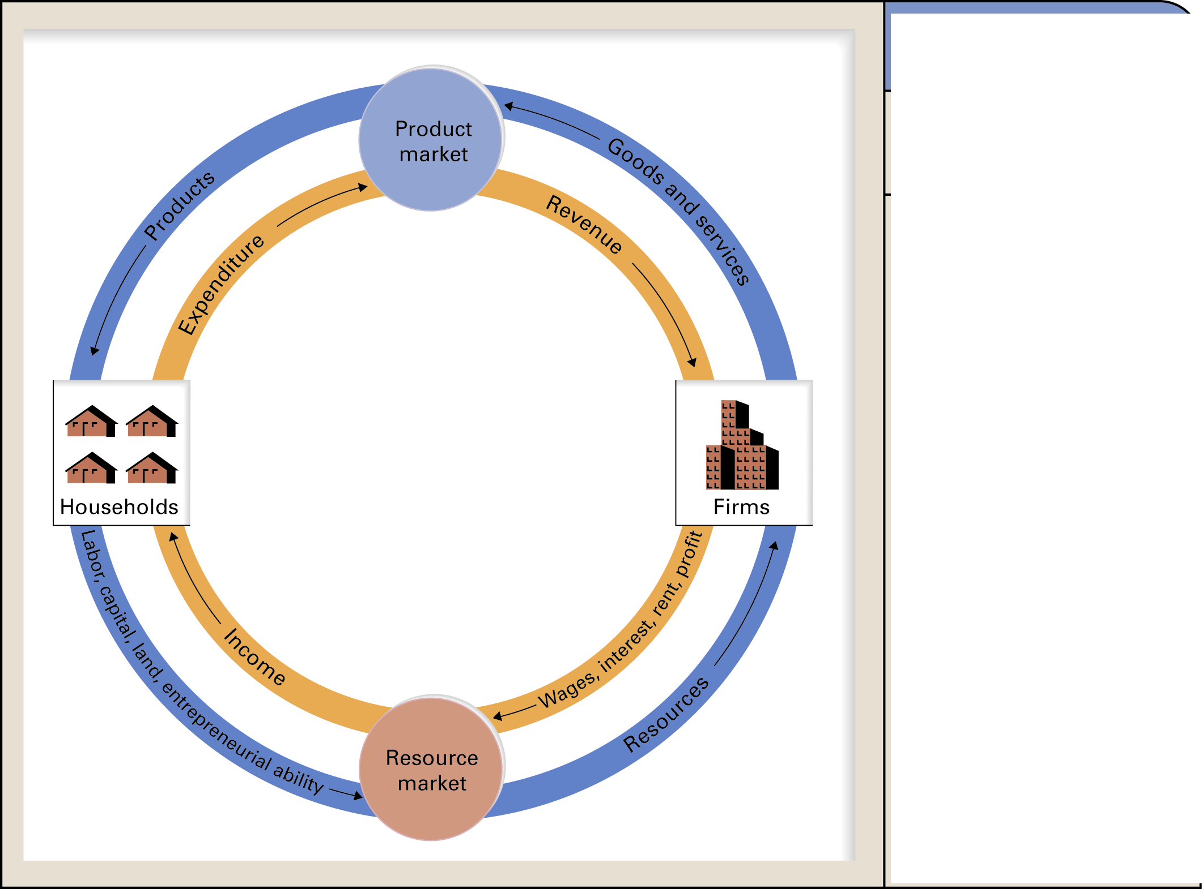
Circular-Flow Model of the Economy
Households
- supply resources
- demand goods and services
Firms
- supply goods and services
- demand resources
Money flows in resource markets determine wages, interest, rents and profits.
Money flows as income to households
Product markets determine the prices for goods and services.
This flows as revenue to firms (source: Dale Bails)

Slide 10
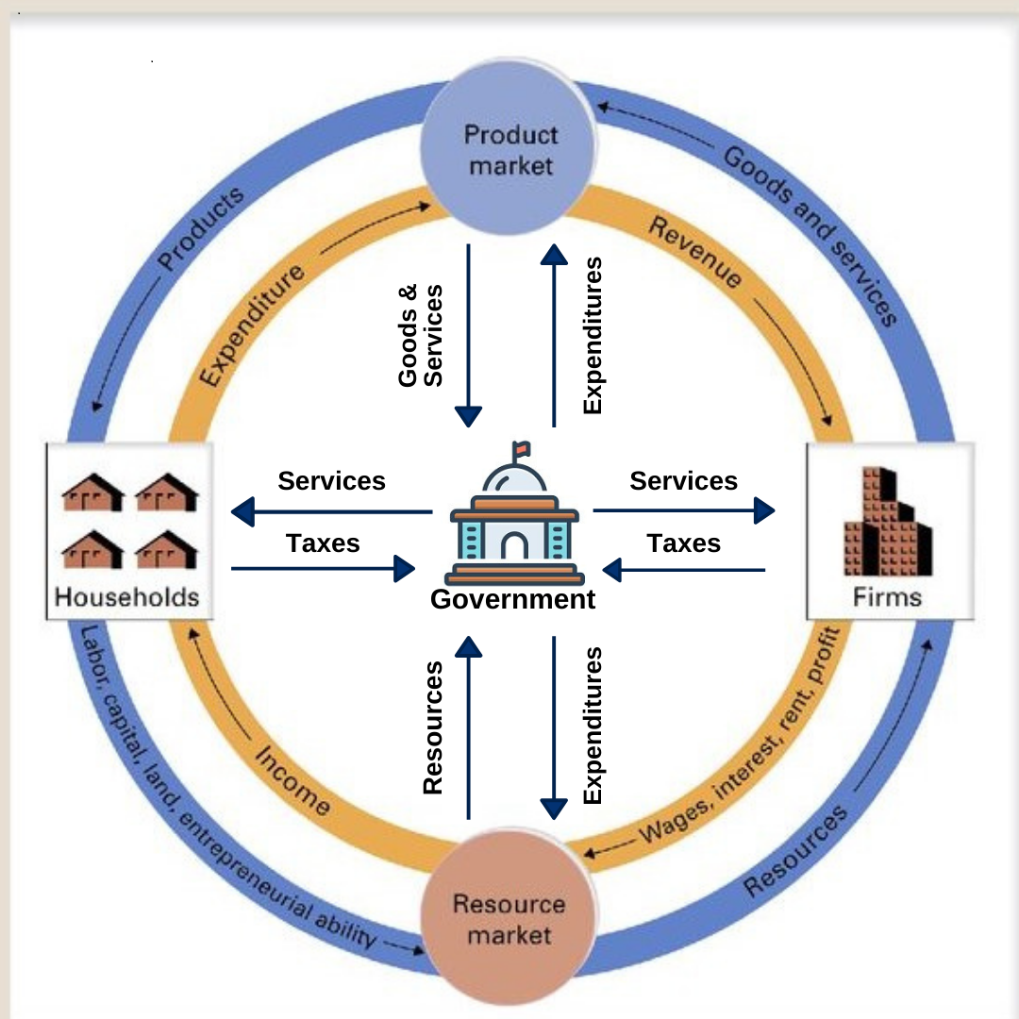

Slide 11
Fundamentals of Economic Activity
Managerial economics deals with limits
  Limited budgets
  Limited time
  Limited ability to produce
How do we make the most of limits?
How do we allocate scarce resources?
Notes:
4

Slide 12
Themes of Managerial Economics
Consumers
  Limited incomes
  Consumer theory – describes how consumers maximize their well-being, using their preferences, to make decisions about trade-offs
  How do consumers make decisions about consumption and savings?

Slide 13
Themes of Microeconomics
Firms
  What types of products do firms produce?
    Constraints on production capacity and financial resources create trade-offs
  Theory of the Firm – describes how these trade-offs are best made
Notes:
7

Slide 14
Themes of Microeconomics
Prices
  Trade-offs are often based on
    prices faced by consumers and producers
  Workers make decisions based on
    prices for labor – wages
  Firms make decisions based on
    wages
    prices for inputs and
    prices for the goods they produce

Slide 15
Themes of Microeconomics
Prices
  How are prices determined?
    Centrally planned economies – governments control prices
    Market economies – prices determined by interaction of market participants
  Markets – collection of buyers and sellers whose interaction determines the prices of goods

Slide 16
What is a Market?
Market Definition
  Determination of the buyers, sellers, and range of products that should be included in a particular market
Notes:
17

Slide 17
What is a Market?
Functioning of the Market
  Most interesting questions in economics is concerned with the functioning of markets
    Why are there a lot of firms in some markets and not in others?
    Are consumers better off with many firms?
    Should the government intervene in markets?
Notes:
18

Slide 18
Types of Markets
Perfectly competitive markets
  Because of the large number of buyers and sellers, no individual buyer or seller can influence the price
    Example: Most agricultural markets
  Fierce competition among firms can create a competitive market
Notes:
19

Slide 19
Types of Markets
Noncompetitive Markets
  Markets where individual producers can influence the price
    Electricity market
    Cartels – groups of producers who act collectively
    Example: OPEC dominates with world oil market
Notes:
20

Slide 20
Market Price
Transactions between buyers and sellers are exchanges of goods for a certain price
  Market price – price prevailing in a competitive market
    Some markets have one price: price of gold
    Some markets have more than one price:
      Detergents - price of nirma versus wheel
Notes:
21

Slide 21
Theories and Models
Economics is concerned with explanation of observed phenomena
  Theories are used to explain observed phenomena in terms of a set of basic rules and assumptions:
    The Theory of the Firm
    The Theory of Consumer Behavior
Notes:
8

Slide 22
Theories and Models
Theories are used to make predictions
  Economic models are created from theories
  Models are mathematical representations used to make quantitative predictions
Notes:
9

Slide 23
Positive & Normative Analysis
Positive Analysis – statements that describe the relationship of cause and effect
  Questions that deal with explanation and prediction
    What is the impact of AI on the growth of service sectors?
    What is the impact of an increase in the fuel excise tax?
Notes:
11

Slide 24
Positive & Normative Analysis
Normative Analysis – analysis examining questions of what ought to be
  Often supplemented by value judgments
    Should the government go for prohibition?
    What should be the minimum wages for unskilled laborer?
    What should be the speed limits on highways?
Notes:
12

Slide 25
Real Versus Nominal Prices
Comparing prices across time requires measuring prices relative to some overall price level
  Nominal price is the absolute or current Re price of a good or service when it is sold
  Real price is the price relative to an aggregate measure of prices or constant Re price
Notes:
22

Slide 26
Real Versus Nominal Prices
Consumer Price Index (CPI) is often used as a measure of aggregate prices level
  Records the prices of a large market basket of goods purchased by a “typical” consumer over time
  Percent changes in CPI measure the rate of inflation
Notes:
25

Slide 27
Real Versus Nominal Prices
Calculating Real Prices
Notes:
25

Slide 28
Real Versus Nominal Prices
Nominal Price – Absolute price of a good unadjusted for inflation
  Price of rice Rs 7/kg in 2000-01 and in 2019-20 price is Rs 40/kg
Consumer price index – measure of aggregate price level
  2000-01 - base 100; 2019-20 - 800
Real Price is price of a good relative to an aggregate measure of prices, price adjusted for inflation
  at 2000-01 prices for 2019-20 – (100/800*40)

Slide 29
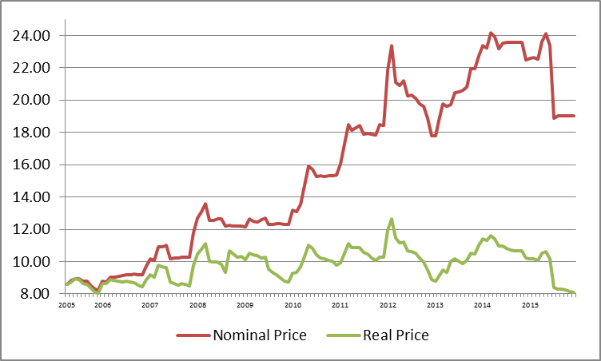
Milk Price paid by Mysore Milk Union to Farmers

Slide 30
Course Objectives
To analyze firm-level economic problems and understand their consequences, to compare alternative solutions to these problems, to understand the market and regulatory environment in which they operate, and to take informed and appropriate decisions subject to various constraints and targets.
To help product managers to identify right markets, product features and understand the characteristics of the market they are operating in and take appropriate decision regarding product and pricing

Slide 31
Focus of the course
Market mechanism
Consumer behaviour
Firm behaviour
Market structure, Conduct and Performance

Slide 32
Module 1: Demand and Supply
Module provides an understanding of basic determinants of demand and supply, the nature of demand and supply curves and their interaction in the market, and important concepts such as price elasticity of demand and supply and market equilibrium. Relevance of these concepts for product managers is discussed.

Slide 33
Module 2: Consumer Demand and Demand Estimation
Module acquaints students with the basic concepts and theories relating to consumer behavior under certainty. It introduces important concepts such as maximization of utility, budget constraints, preferences, and indifference curves. It explains how consumer preferences can be elicited and can be used as an important input in product development situations. The link between consumer theory and demand curves is also explained. Methods of empirically estimating demand are discussed

Slide 34
Module 3: Theory of Firm and Market Structure
The focus of this module is to explain the main concepts and tools pertaining to production theory. These include a wide range of concepts, such as, total and marginal product, diminishing returns, input substitution, choice of optimal input combinations, returns to scale, costs, revenues, profits, and short run and long run decision making by firms. The link between production theory and the supply curve is explained. This module also covers different types of markets, including, perfect competition, monopoly, oligopoly, and monopolistic competition and their characteristics.

Slide 35
Module 4: Firm Behaviour, Pricing and Game Theory
The module highlights the sources of differences in these various market structures and the implications for firm and industry output, prices, efficiency, and profits. In the course of discussing these different market structures, the module also touches upon important topics such as pricing strategies of firms, strategic and game-theoretic aspects of firm behavior, cartels and collusion, and competition policies

Slide 36
Evaluation
Class Participation -20%
Midterm exam – 30%
Term Paper and Presentation – 50%
  Individual – 10%
  Group – 40%

